Slide 1
Bigfix Learning Session

Slide 2
Agenda
Bigfix platform basics
Upgrading clients to 9.2.9.36 using the console fixlets
Bigfix computer A&A properties and keyfiles
Utilizing computer properties to manage the reboot and Java update policies on clients
Bigfix web reports demo basics
Customizing Bigfix web reports and using USGS custom reports

Slide 3
Bigfix Platform Basics

Slide 4
The Bigfix Platform
Is a client-server application that allows for near real-time continuous vulnerability assessment, with minimal network or computer resources and supports numerous OS’s including Windows, Linux, Mac OS, Unix, and more
The core application and services are managed by DOI and the relay services are managed by Bureau staff working with local site administrators
Is designed to bring fast and responsive visibility into the computing state of your environment
Supports remediation capabilities accessible via the Console server
Supports extensive reporting capabilities via the Web Reports server

Slide 5
The Bigfix Architecture

Slide 6
BigFix Infrastructure Components
BigFix Client – agent component that is installed on each computer and communicates with the BigFix Server
BigFix Server – server component that is the central communication piece of the system
BigFix Relay – computer that “relays” information from BigFix Clients to BigFix Server and vice versa
BigFix Web Reports – read-only interface to the results collected by the system and stored on the BigFix server
BigFix Console – administration interface to system

Slide 7
Bigfix Terminology
Content in BigFix are either Fixlets, Tasks, Baselines, or Analyses.
Fixlets/Tasks are Questions with True/False answers that BigFix clients Gather over TCP:52311 from the BigFix Server and Continually Evaluate.
Baselines are multiple Fixlets/Tasks grouped together.
Applicable computers for fixlets are systems that Last Reported True to the BigFix Server.
Analyses are groups of common Properties.
Properties are Questions with String Answers and are otherwise the same as Fixlets.
Sites are Containers for similar content (like a Windows Folder).

Slide 8
Where do Fixlets come from?
BigFix
Uses existing content and converts it into Fixlets
Vendor Security Patches
Secure Configuration Baselines
DOI Staff
DOI-Wide specific content meant to assist bureaus with common requirements
USGS Staff
USGS-Wide content meant to assist local sites with common USGS requirements
Component Operators
Component specific content

Slide 9
Where do Analyses and their Properties come from?
Sources
BigFix: Basic out-of-the-box properties
DOI: Additional global properties
Component Console Operators: Component specific properties
Analyses Activation
Not all analyses/properties are activated

Slide 10
Questions?

Slide 11
Upgrading Bigfix Clients to 9.2.9

Slide 12
Upgrade Bigfix Clients to 9.2.9
Sites can deploy the latest client update 9.2.9 using fixlets in the Bigfix console.
We have updated the relays at 99% of the sites to 9.2.9 now. The client upgrade fixlet is fast, silent, and requires no restart. The fixlets available by OS platform are as shown below.
The deadline for upgrading clients is March 31st and will be included in ePatching activities this month.

Slide 13
Questions?

Slide 14
A&A Computer Properties and Keyfiles

Slide 15
Bigfix Computer Groups and Properties
DOI requires all bureaus to begin the transition from the use of dynamic computer groups to the use of computer properties as the means to organize systems for reporting and management. Groups are very resource-intensive method to organize systems.
Each time a system reports to Bigfix, up to 4 times an hour, the system must evaluate each group membership rule to determine if it should join. The use of properties greatly reduces the resources needed to identify systems as the information is stored as part of each computer record.
These groups are used to define management permissions as well as for A&A reporting and other reporting needs.

Slide 16
Keyfiles and A&A Properties
To ensure the accuracy of computer properties, it is vital that each site review and ensure the required keyfiles are implemented correctly on all systems.
Beginning in December 2016, a USGS-wide action began to populate or update properties values in Bigfix by evaluating the keyfiles once a day on all systems.
The analysis can detect duplicate conflicting keyfiles as well as the absence of a required keyfile
Keyfile | Bigfix Computer Property Name
Bureau | Bureau
System | AA-System
Asset | AA-Child

Slide 17
Ensuring Accurate Keyfiles on Clients
Please refer to the Bigfix Master Keyfiles List for current information about the naming standard for keyfiles.
For Windows clients, sites can use GPO’s and/or SCCM configuration baselines following the guidance at the Creating a Managed IEM Keyfile Baseline page.
For non-Windows clients, the Bigfix console offers fixlets to help manage keyfiles.
DOI-Wide: Create and Deploy key File – Creates one keyfile with the filename specified
DOI-Wide:DELETE key File – Deletes one keyfile with the filename specified

Slide 18
Questions?

Slide 19
Computer Properties to Manage Reboot and Java Update Policy Exceptions

Slide 20
Background
The USGS BigFix team has been managing the Reboot/No Reboot and Java exceptions using manual entry of systems from SCCM and Google sheets data into computer groups in Bigfix.
This can be incomplete and lead to inaccuracies regarding Bigfix actions.
The USGS Bigfix team working with DOI Bigfix team staff have created computer properties that can be leveraged by local site administrators to set exceptions to some important default policies.
These include not forcing restarts after patching or ensure Java updates are not install on certain systems.
There is also an ePatching exception property, but it’s use will be strictly monitored since any exception to ePatching processes must be approved by the IT Security Office.

Slide 21
Bigfix Exception Properties
Client Reboot Exceptions - If set ‘True’, the client will be exempt from reboot
Client Actions Exceptions - If set ‘True’, the client will be exempt from ePatching
Client Java Exceptions - If set ‘True’, the client will be exempt from Java updates
These properties have 3 values.
True - means there IS an exception for this client
False - means there is NO exception for this client
not set - (Default setting) means no one has set the property either way, treated as False

Slide 22
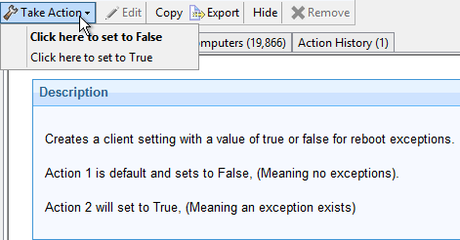
Bigifx Fixlets to Manage Exception Properties
There are three associate Fixlets to set these properties.
DOI-WIDE: Set Client Reboot Exceptions (True or False)
DOI-WIDE: Set Client Action Exceptions (True or False)
DOI-WIDE: Set Client Java Exceptions (True or False)
Each Fixlet has two possible Actions.
“Click here to set to False”
“Click here to set to True”
Note: If the property is not set through an Action, the corresponding property will show "not set".

Slide 23
Exception Properties Implementation Procedures
Guidance and procedures about how to set and use these properties can be found at the following TST page:
https://tst.usgs.gov/applications/asset-management/ibm-endpoint-manager/bigfix-exception-properties-and-fixlets/

Slide 24
Questions?

Slide 25
Web Reports Basics

Slide 26
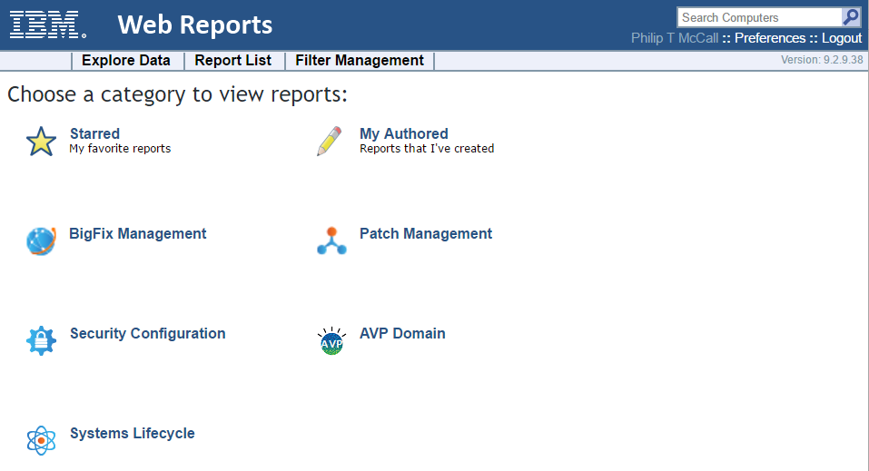
Initial Homepage

Slide 27
Menus and Getting Around
In the main window, you should see:
Starred: This option brings up a list of the Reports that you have starred as important.
My Authored: This option brings up a list of Reports that you have personally authored.
Domains: These icons can be selected to view the list of Web Reports associated with the selected domain.
At the top right of the window is a search box and two user selections:
Search Computers: The search box, top right, allows you to select computers by properties including Name, IP Address, OS, CPU, and Last Report Time.
Preferences: For your personal login, you can set preferences including your opening splash page and the number of results you want to print on each page.

Slide 28
Menus and Getting Around
Below this are the two main section headers in tab form:
Explore Data: This option lets you filter and view your data on your BigFix Clients, Fixlet messages, Tasks, Actions, Operators and more. This section also allows you to create your own custom reports as well as graphical charts.
Report List: This option exposes all the reports (built-in and custom) that are available to you. You can filter the reports, modify their visibility and set up schedules for printing them out.

Slide 29
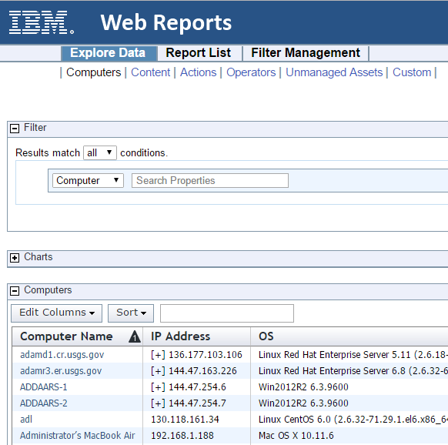
Explore Data
1. Click Explore Data from the top menu bar.
2. The Computers report is the default, and should be displayed.
Notice that you can explore other data sets, including Fixlet Content, Actions, Operators and more.

Slide 30
Explore Data Key Areas
Computers – Data/Metadata on computers and their reported properties
Content – Data on Fixlets/Tasks/Baselines including applicable computers
Unmanaged Assets – Data on devices found by DOI asset discovery service

Slide 31
Web Reports Demo

Slide 32
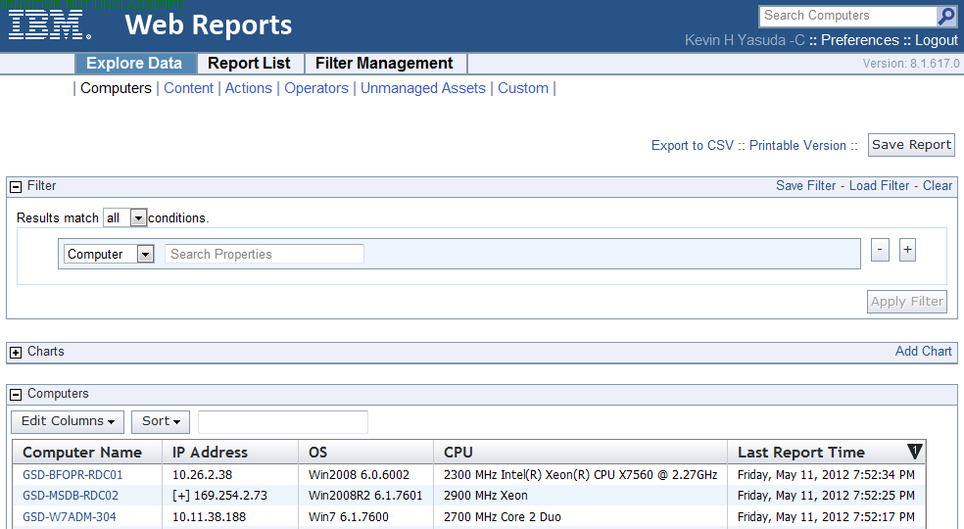
Computer Properties Report

Slide 33
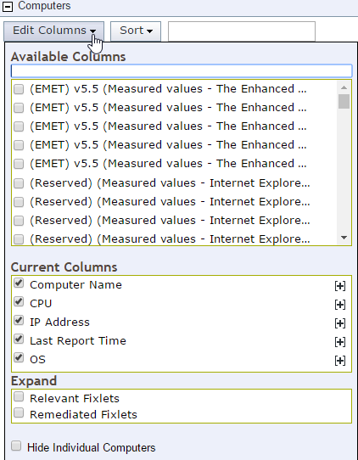
Viewing Computer Properties
Use the Edit Columns to control the data fields
Selecting from the Available Columns list adds it to the data table. To remove a Property, uncheck it in the Current Columns
Checking a selection in the Expand list box will add the name of relevant or once relevant fixlets to the data table
Checking Hide Individual Computers will convert the computer name field into a count of systems with the same properties

Slide 34
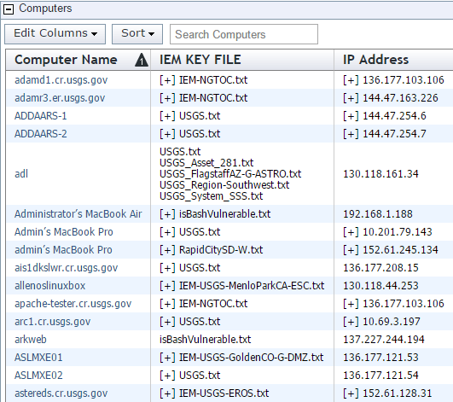
Handling Properties with Multiple Results
Properties may have multiple results
For example: IEM KEY FILE or IP Address
Use the [ + ] to expand the results

Slide 35
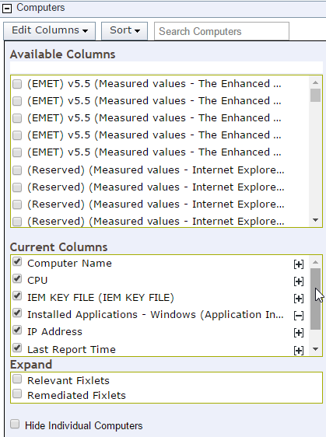
Globally Expanding Multiple Property Results
Use Edit Columns > Current Columns
Use the [ + ] to expand all multiple property results for that column
Will create a new row per value

Slide 36
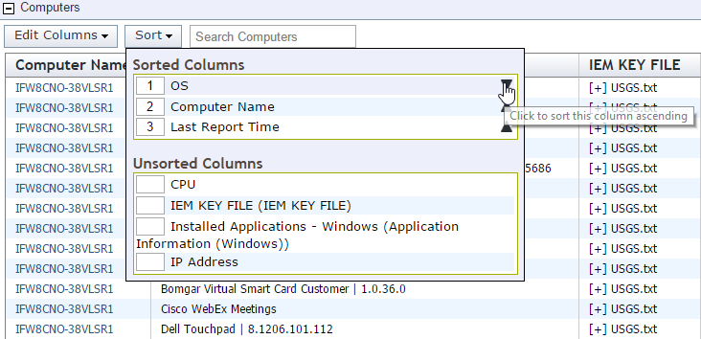
Multiple Field Sorting
Use the Sort menu to sort on multiple fields

Slide 37
Saving Explore Data Configuration
Clicking the Save Report button at the top right of the screen will prompt you to provide a name for your specialized report.
Columns, Sort Order, and Filter settings are saved.
The name you provide will be entered into the Report List, and labeled with you as the author.

Slide 38
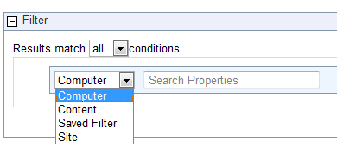
Filtering is your best friend
Computers can be filtered by analyses/properties such as OS, Subnet, IP, Active Directory path and other collected properties.
Content can be filtered by Site, Fixlet criticality and other Fixlet properties.

Slide 39
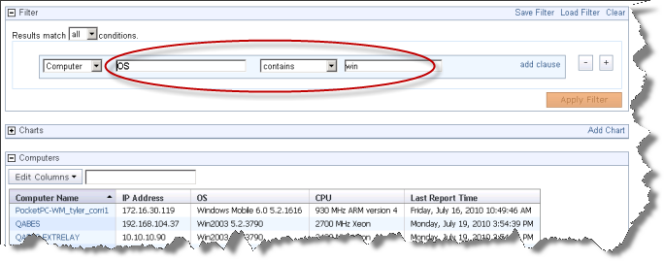
Filtering Data
Computers can be filtered by any combination of properties.
Click the Apply Filter button to get an instant view of the impact of your filter.

Slide 40
Useful Computer Properties for Filtering
Last Report Time
OS
IP Address
Subnet Address
Computer Name
Computer Type
User Name
Computer Groups
Active Directory Path
Installed Applications - Windows (Application Information (Windows))

Slide 41
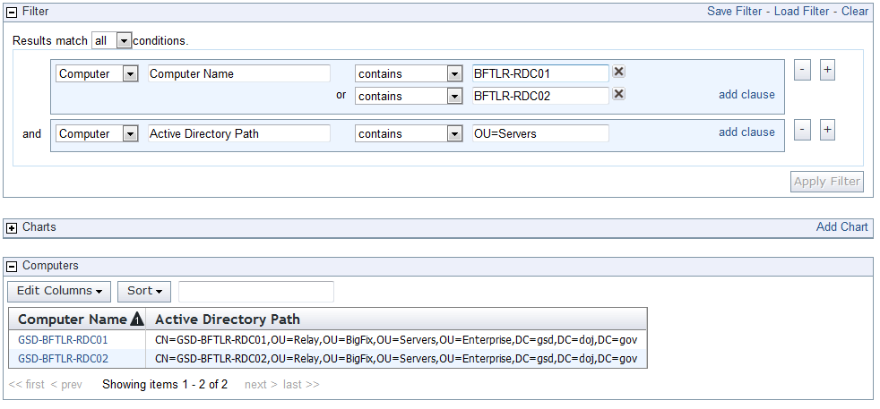
Filter Options
Add Clause will add an OR condition
The + Button will add an AND condition
Save Filter will allow you to store filters for later and build more complex filters

Slide 42
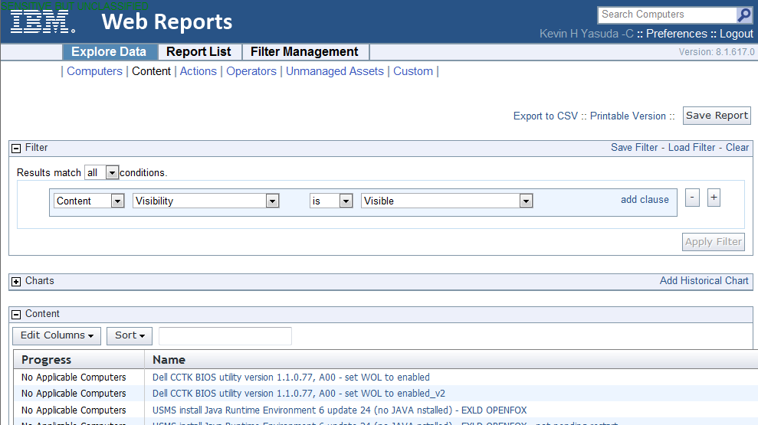
Exploring Content
Provides a view of content and the computers applicable to them

Slide 43
What is in the “Progress” column?
For analyses locality is displayed: globally/locally
For fixlets, tasks, and baselines the percentage still relevant of all computers that were ever once relevant is displayed

Slide 44
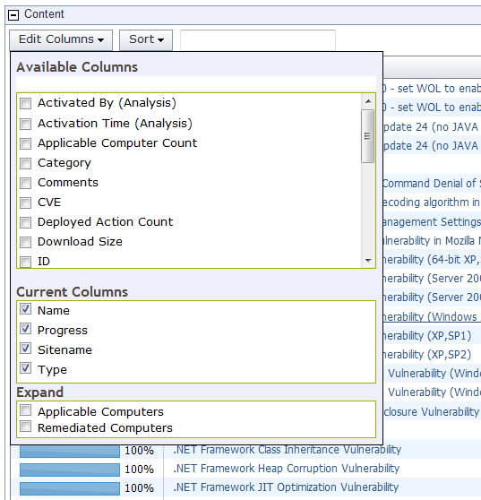
Adding Content Fields
Available Columns lists attributes about the content (not computers)
Current Columns lists what is included in the data
Expand allows you to show relevant or once relevant computer names

Slide 45
Content Filters
Filtering content is critical
There are more than 12,000 fixlets available in the console
Not all fixlets are security or patch related
Useful Content Filters
Site
Name
Source Severity (vendor’s severity)
CVE
Applicable Computer Name
Applicable Computer Count

Slide 46
Useful Sites
Patches for Windows (English) –contains patch content from Microsoft
Updates for Windows Applications – contains non-Microsoft patches for Windows applications (e.g. Adobe Flash, Java Runtime Environment)
Vulnerabilities to Windows Systems – contains patches from the OVAL vulnerability repository
… Checklist for … - a series of sites that contain secure configuration content
Patches for … - a series of OS vendor patches

Slide 47
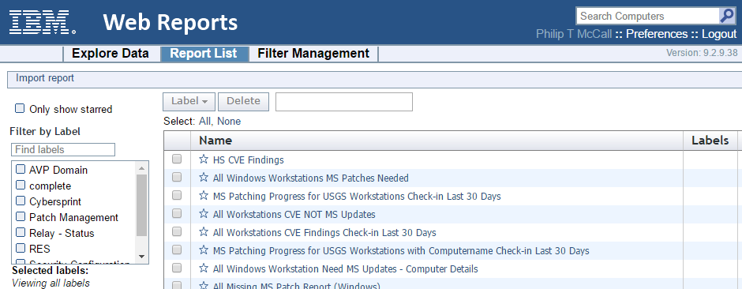
Viewing Reports
Click Report List from the top tab bar
The list of reports is displayed. Simply click a report link to see the report
You can search reports by typing in the circled box
Note that you can filter the reports by label and author

Slide 48
Exporting Report Data
Exporting is very useful
Export as CSV to import to Excel
Excel is better at a few things
Printing
Calculations
Data Visualization
Pivoting

Slide 49
Useful Custom Reports
The following Bigfix custom reports check the status on local relay services, gather details about clients for inventory purposes, and review current security patches needed. Copies of the reports can be saved so that further local customization can be performed.
USGS-Wide: BES and RES Relay Health Check
USGS-Wide: Computer Inventory Details
USGS-Wide: Windows - All Needed Security Patches Rated Low to Critical
USGS-Wide: Mac OS X - All Needed Security Patches
These report links as well as future additions can be found at: https://tst.usgs.gov/applications/asset-management/ibm-endpoint-manager/bigfix-web-reports-list/

Slide 50
Questions?

Slide 51
Thank You!
Thank you for attending today’s training session. Questions or issues can be submitted to the Service Desk ( servicedesk@usgs.gov ).

